Slide 1


DOG BREED IMAGE CLASSIFICATION
Deep Learning Implementation using the fastai Library
SUBMIT BY : TAIR SAIDA
COURSE : DEEP LEARNING
SUBMITION DATE : 2025
GITHUB LINK: HTTPS://GITHUB.COM/TAIRSA/DOG-BREED-IMAGE-CLASSIFIER.GIT

Slide 2

DEEP LEARNING, 2025
PROBLEM DEFINITION
Task: Multi-class image classification.
•Predict the dog breed from an input image.
•Breeds: Beagle, Doberman, Golden Retriever, Labrador Retriever, Shih-Tzu.
•Motivation: Useful for apps and organizing image collections and I wanted to choose a subject that I love so it was very fun and interesting to do it about dogs.

Slide 3

DEEP LEARNING, 2025
CHALLENGES BEFORE MODELLING
•Breeds may look similar like Golden Retriever and Labrador Retriever.
•Variation within each breed.
•Collecting a big and qualitative data base.
ג==

Slide 4

DEEP LEARNING, 2025
DATASET COLLECTION
Sources: Stanford Dogs Dataset (A well-known academic benchmark).
Data Organization Steps: Sampling: A subset was created, containing 150 images for each of the 5 selected breeds (Total: 750 images). Splitting: The dataset was manually organized into train (training set) and test (validation set) folders, using an 80%/20% split.

Slide 5
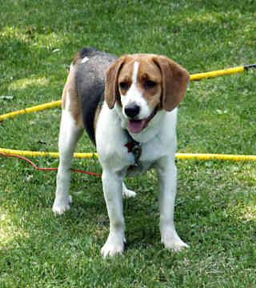
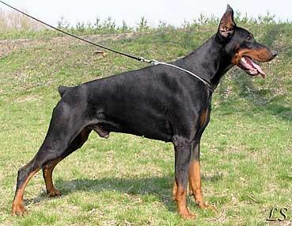
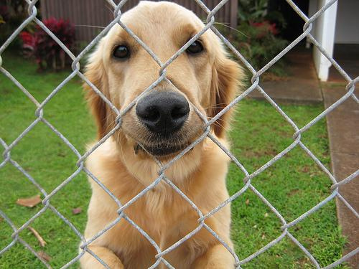
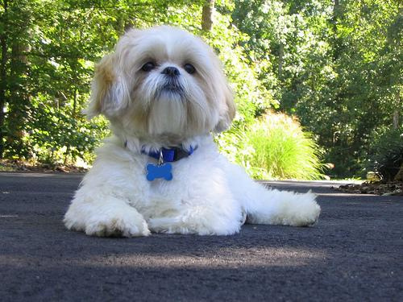
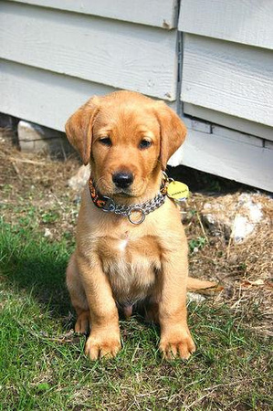
DEEP LEARNING, 2025
DATASET SIZE AND EXAMPLES
* Train Set: 600 images (5 breeds x 120 images each). * Test Set: 150 images (5 breeds x 30 images each).
Beagle
Doberman
Golden Retriever
Shih-Tzu
Labrador

Slide 6

DEEP LEARNING, 2025
MODEL PIPELINE
  fastai approach: leveraging a pre-trained network's foundational knowledge of image features.
  Architecture chosen : I used the vision_learner(dls, resnet34, metrics=accuracy) function to load the pre-trained weights.
  Training details: learn.fine_tune(3): This function automates the best practice for Transfer Learning.

Slide 7
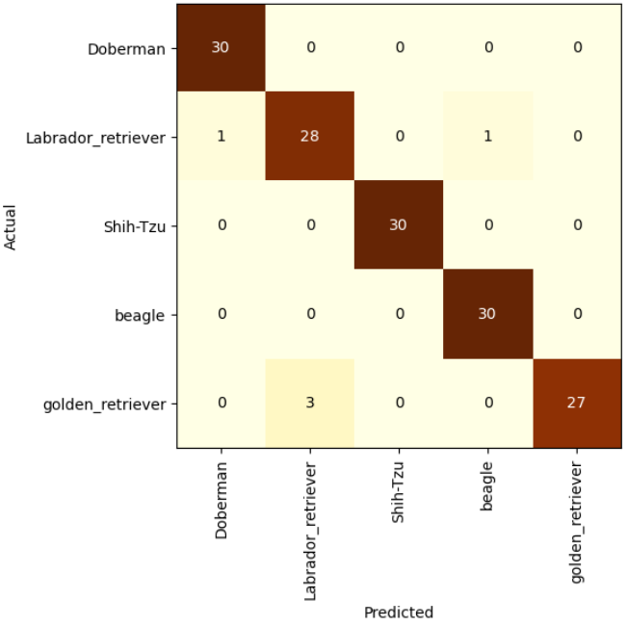
DEEP LEARNING, 2025
RESULTS
  Confusion Matrix
  Final Validation Accuracy
96.66% The model successfully mastered the fine-grained classification task on the selected subset

Slide 8

DEEP LEARNING, 2025
RESULTS
  What the model learned / struggled with:
Strengths: The model learned to identify key fine-grained features such as muzzle shape, coat texture, and overall silhouette, which distinguishes the breeds effectively.
struggle: The highest confusion occurred between the two visually similar retriever breeds, which is a common challenge in fine-grained classification.

Slide 9

DEEP LEARNING, 2025
CHALLENGES ENCOUNTERED
  Noisy labels:
  Unexpected behavior:
Despite cleaning, some images contained low quality, poor lighting, or extreme angles, which potentially increased the difficulty of the learning task.
The primary challenge was the high degree of visual similarity between certain breeds (e.g., the retrievers), requiring complex feature differentiation by the model.

Slide 10
DEEP LEARNING, 2025
THANK YOU

